Slide 1
Spatial analysis of historical cranial measurements
Project Update
Andrew Laws

Slide 2
Project Overview
Topic area
Developing identifiers of geographic origin using cranial measurements
Forensic anthropology
Subset of Indian states
Data with 162 observations from 17 Indian states from 1909
Questions
Do cranial measurements exhibit spatial autocorrelation at the state-level in India?
Do cranial measurements from different tribes or cultural groups exhibit spatial autocorrelation?

Slide 3
Tools
R/R-studio
Spatial and tabular libraries
ArcGIS Online
Data creation
Microsoft Excel
Indian and Sri Lankan government data portals

Slide 4
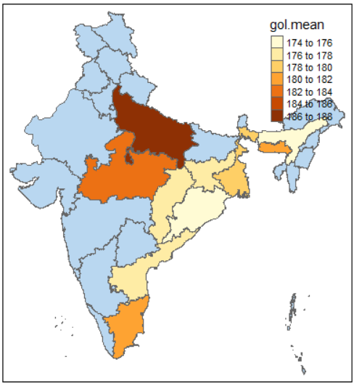
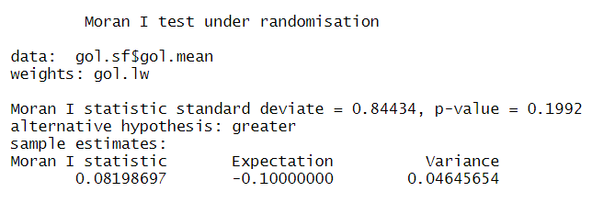
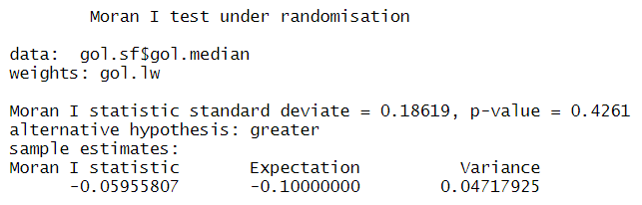
Progress
Cleaned up tabular data
ESDA
Calculated Moran’s I for mean and median glabello-occipital length (GOL)
Mean GOL Moran I
Median GOL Moran I

Slide 5
Challenges
Final tabular data
Spatial scale and quantity of observations
Means and median
Spatial data availability
Methodology for field

